Slide 1
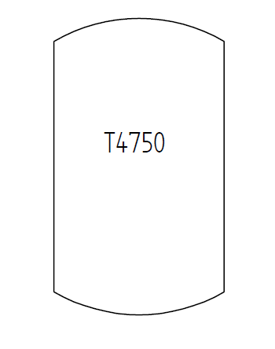
Test Case E13V01 – Tank with Plant Structure Information
Tank with tag name
(no information about tag name parts: prefix, sequence number, suffix).
The tank is part of a ProcessPlant with name „Kölsch Plant“. The ProcessPlant is part of the following hierarchy:
Isa95Enterprise „DEXPI Beer Inc.“
SiteIsa95 „Cologne“
ProcessPlant „Kölsch Plant“
The tank is located in PlantTrain „Train 2“.
T1301

